Slide 1

Developing A YEAR ROUND TACKLING PROGRAM
Vince DiGaetano
Wagner College, Defensive Assistant
USA Football, Heads Up Football, Regional Master Trainer
@CoachDig
@Wagner_Football

Slide 2




Developing A YEAR ROUND TACKLING PROGRAM
WHERE DO WE START?
HOW ABOUT AT THE BEGINNNING?
Started coaching HS in 2001
MOVED TO COLLEGE
IN 2005
2009 off season
decided to spend less time on scheme and more time on skill and development
2013
BECAME
HEADS UP FOOTBALL
MASTER TRAINER
Had opportunity to work with (and against) top talent while only having limited time
2016
BECAME defensive assistant
Took advantage of working with coaches at the youth and high school level to recognize skills players acquire at all levels
Took advantage of having an overall perspective to analyze on a year round basis with full spring football season and strength program
2008
BECAME DEFENSIVE COORDINATOR
2015
BECAME LINEBACKER COACH

Slide 3
Developing A YEAR ROUND TACKLING PROGRAM
SPRING FOOTBALL/SUMMER
START FROM SCRATCH EVERY YEAR
TAKE NOTHING FOR GRANTED
EXPLAIN CHANGES TO PLAN AND WHY ITS BENEFICIAL
INTRODUCE
TEACH
COMPETE
&
CORRECT
EDUCATE
&
EVALUATE
WINTER CONDITIONING
HOW DO WE IMPROVE PHYSICALLY?
Footwork
Grip
Body position
confidence
Post season
What can we learn?
What can we do better?
Who does it great?
FALL CAMP/SEASON
PUT PLAYERS IN BEST POSITION TO BE SUCCESSFUL
REMAIN CONSISTENT
HONEST AND FAIR

Slide 4
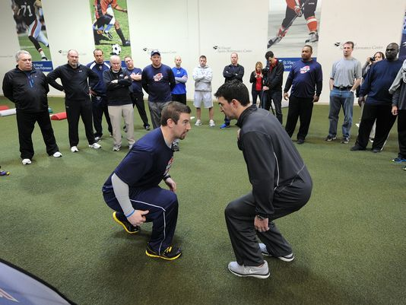
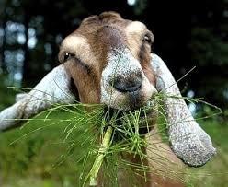

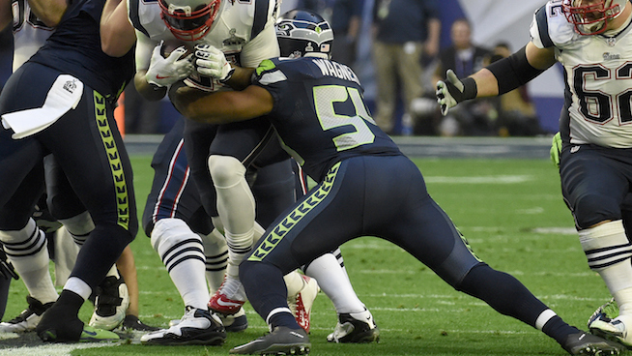
Developing A YEAR ROUND TACKLING PROGRAM
The evolution
Approach
Position
Contact
finish
Heads up
g.o.a.t
Shoulder
5 FIGHTS

Slide 5
Developing A YEAR ROUND TACKLING PROGRAM
The coach/player tackling partnership
We all must understand….
MENTAL
Physical
 | Drills are designed by the actual position they are in All players have to: Line Up Defeat a Block Get to the ball carrier with intent of Getting them down or getting the ball
Need to speak the language
Make it important to them and have fun
Constant and consistent evaluation
“We
…Learn to evaluate
…evaluate to correct
…correct to succeed
…Succeed together
Drills are designed by the actual position they are in
All players have to:
Line Up
Defeat a Block
Get to the ball carrier with intent of
Getting them down or getting the ball

Slide 6
Developing A YEAR ROUND TACKLING PROGRAM
The use of data and statistics
BREAKDOWN:
END OF PLAY
MADE/MISSED
POSITON
ANGLE/STRAIGHT ON
ABOVE/BELOW WAIST
PLAYER
YARDS AFTER FIRST CONTACT
CORRECTION
DRILL
***FIGHT***
TOTAL | DL | ILB | OLB | S | C
1,228 | 244 | 356 | 197 | 268 | 163
Yards after first contact

Slide 7
Developing A YEAR ROUND TACKLING PROGRAM

Slide 8
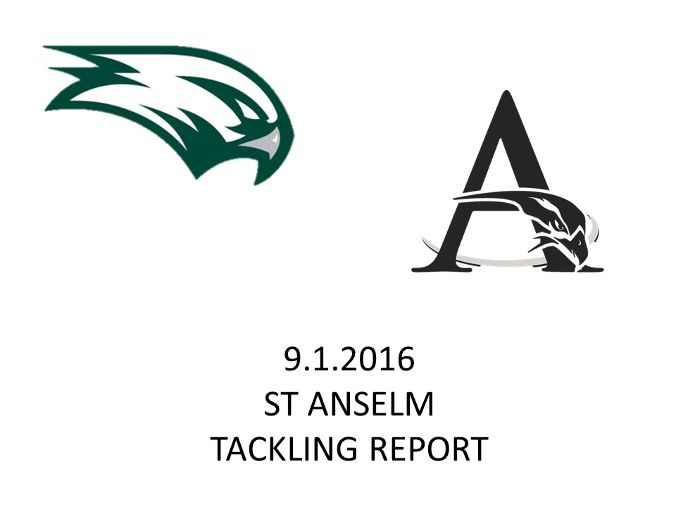
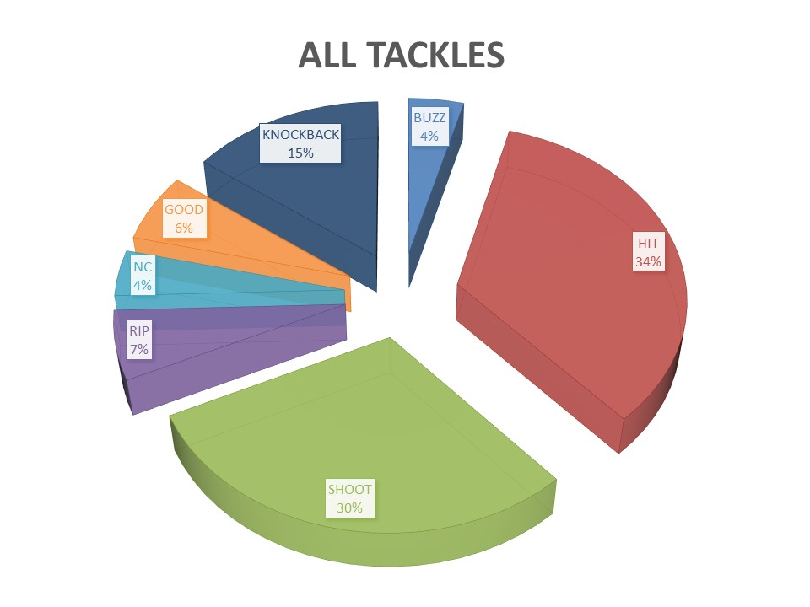
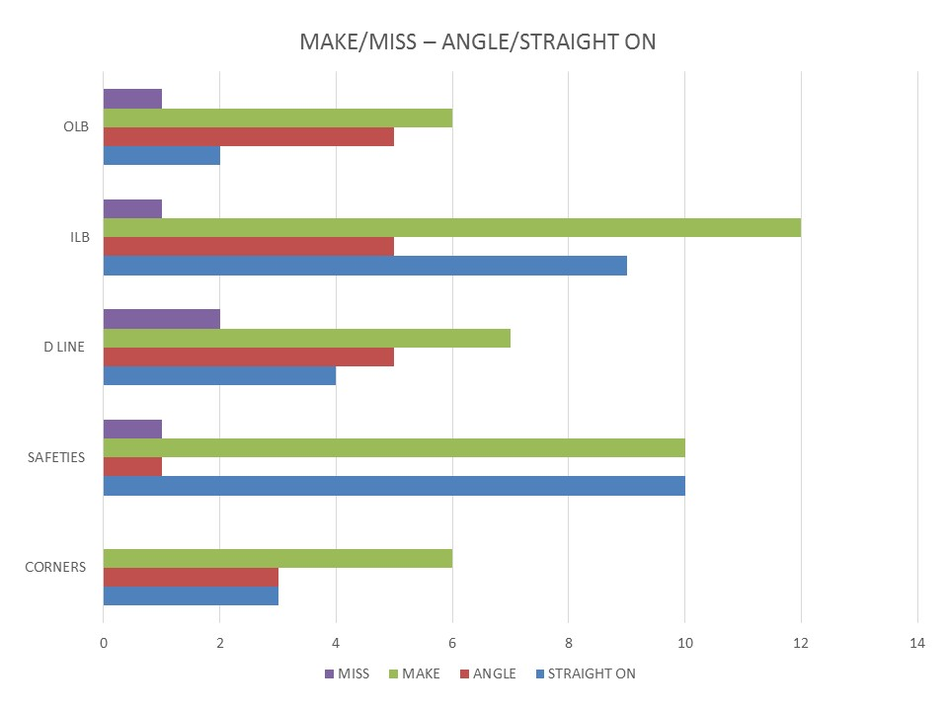
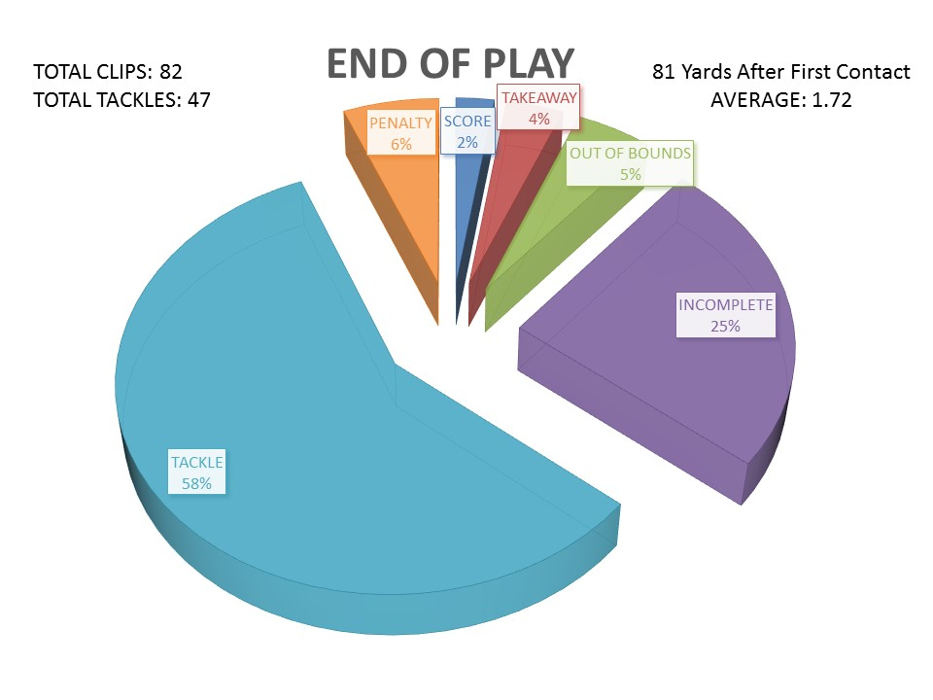
Developing A YEAR ROUND TACKLING PROGRAM

Slide 9
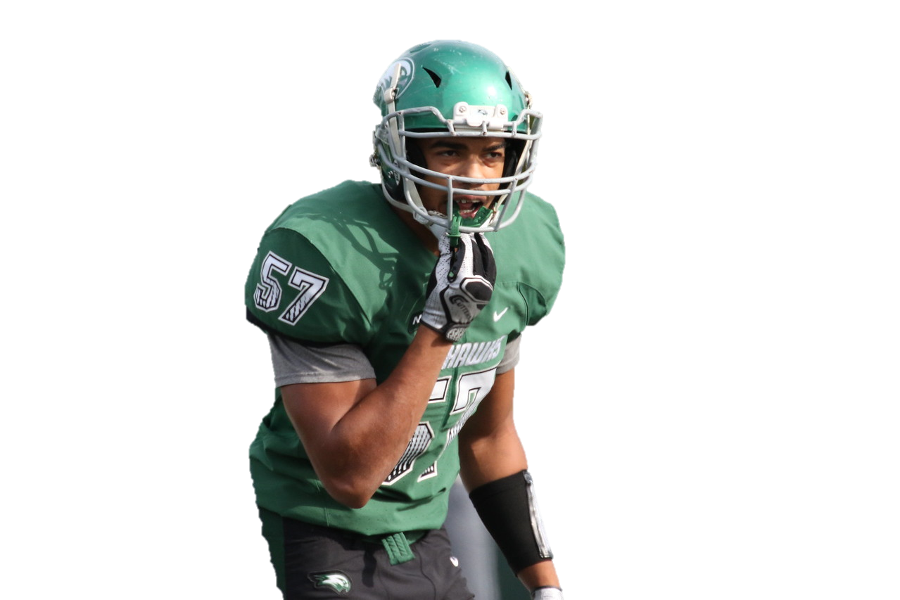
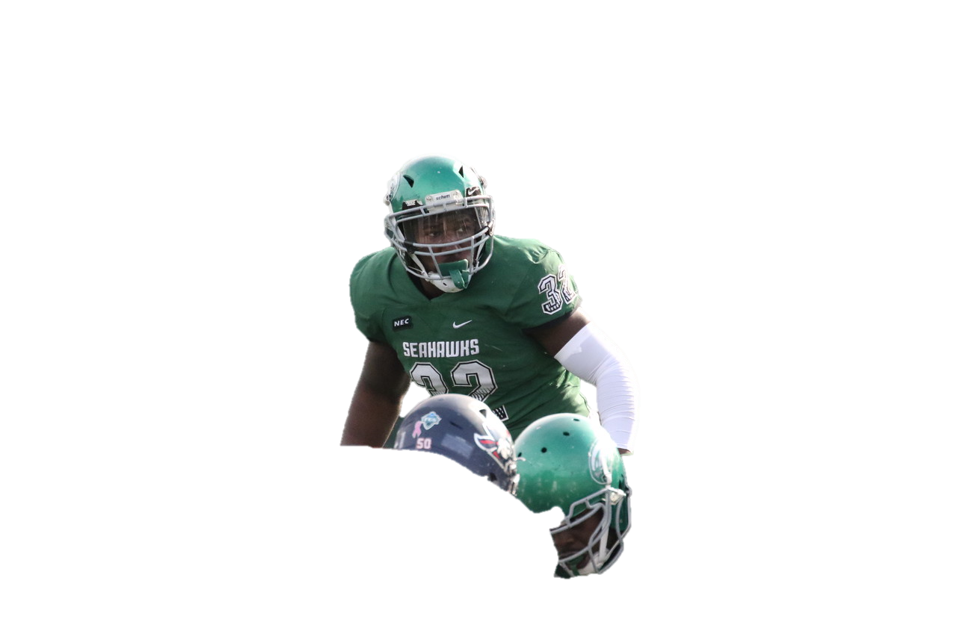
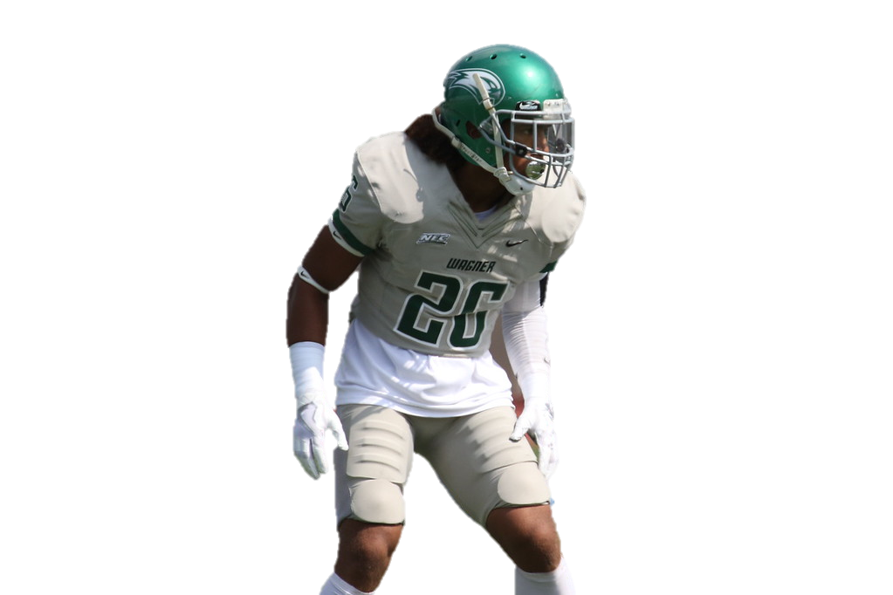
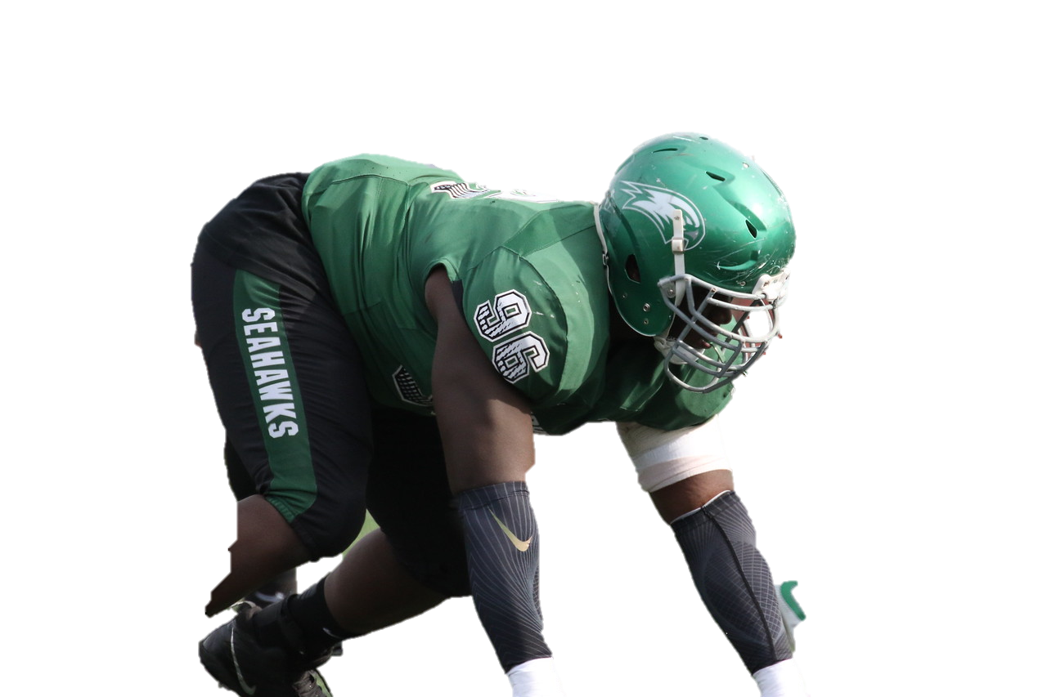
Developing A YEAR ROUND TACKLING PROGRAM
DETERMINING
POSITION
Specific
NEEDS

Slide 10
Developing A YEAR ROUND TACKLING PROGRAM
DEFENSIVE LINE/OUTSIDE LINEBACKERS
Characteristics: PLAY CLOSER TO BALL TAKE ON BLOCKER ALMOST EVERY PLAY
MAIN FOCUS: ONE ARM TACKLING

Slide 11
Developing A YEAR ROUND TACKLING PROGRAM
One arm tear
(PRACTICE FILM)

Slide 12
Developing A YEAR ROUND TACKLING PROGRAM
One arm tear
(game FILM)

Slide 13
Developing A YEAR ROUND TACKLING PROGRAM
INSIDE LINEBACKERS
Characteristics: HAVE TO FIT ON RUN AND Distribute ON PASS
Varied angles OF BLOCKERS
MAIN FOCUS: PVC Tackling

Slide 14
Developing A YEAR ROUND TACKLING PROGRAM
Pvc tackling
(PRACTICE FILM)

Slide 15
Developing A YEAR ROUND TACKLING PROGRAM
Pvc tackling
(game FILM)

Slide 16
Developing A YEAR ROUND TACKLING PROGRAM
SECONDARY
Characteristics: EYES HAVE TO BE IN MULTiPLE PLACES DURING PLAY. PLAY IN MORE OPEN SPACE VS. BETTER ATHLETE
MAIN FOCUS: TRACKING THE FOOTBALL

Slide 17
Developing A YEAR ROUND TACKLING PROGRAM
SWOOP DRIVE
(PRACTICE FILM)

Slide 18
Developing A YEAR ROUND TACKLING PROGRAM
SWOOP DRIVE
(GAME FILM)

Slide 19
Developing A YEAR ROUND TACKLING PROGRAM
compression
(practice FILM)

Slide 20
Developing A YEAR ROUND TACKLING PROGRAM
compression
(GAME FILM)

Slide 21
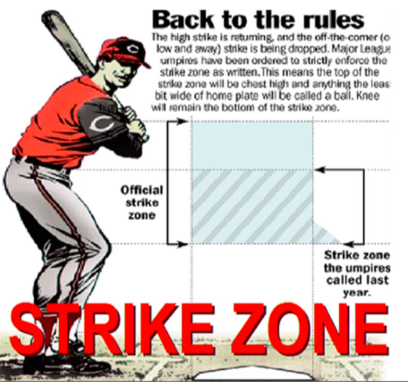
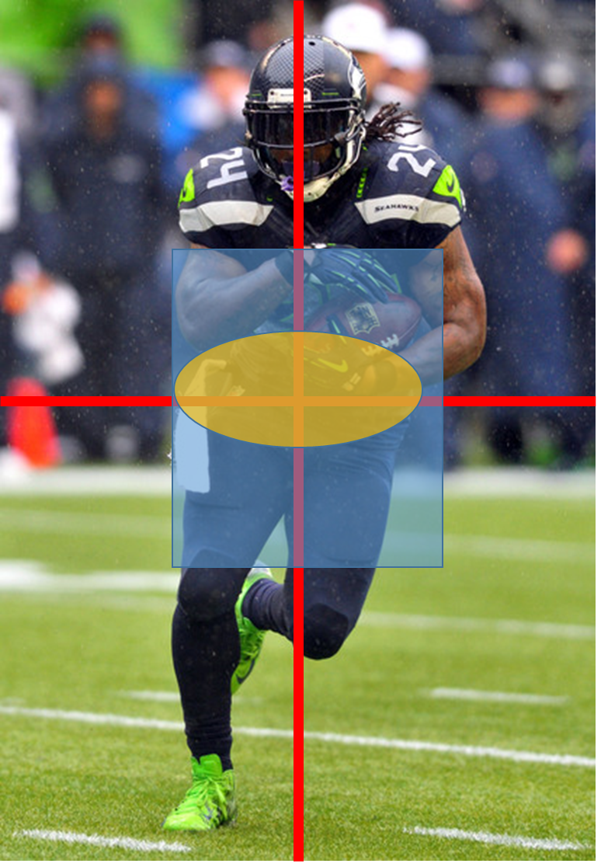
Developing A YEAR ROUND TACKLING PROGRAM
EMPHASIS ON RULES AND RULE CHANGES

Slide 22
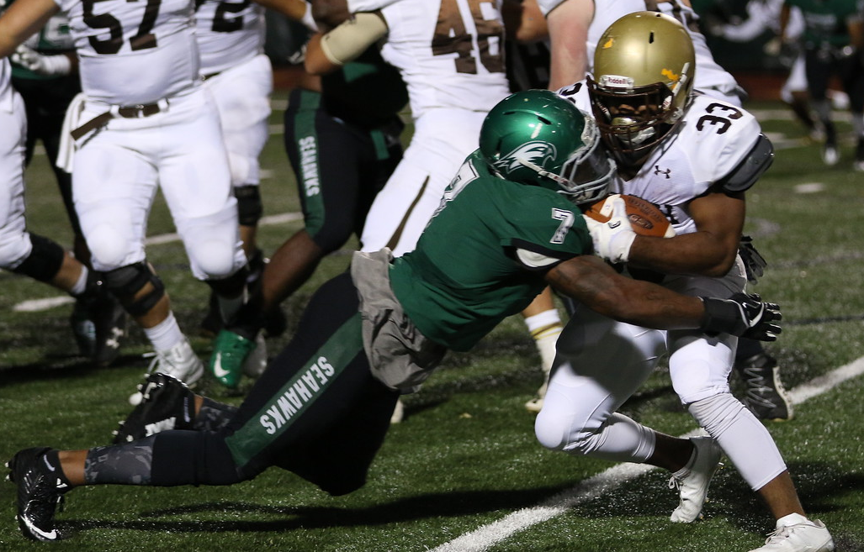
Developing A YEAR ROUND TACKLING PROGRAM
EMPHASIS ON RULES AND RULE CHANGES

Slide 23
Developing A YEAR ROUND TACKLING PROGRAM
Team tackle/game position
(practice FILM)

Slide 24
Developing A YEAR ROUND TACKLING PROGRAM
Team tackle/game position
(game FILM)

Slide 25
Developing A YEAR ROUND TACKLING PROGRAM
In season management of tackling
RECOGNIZE | REFLECT | RESPOND | RECORD
be excited about success-take nothing for granted | show the growth from week to week Remind them it is a process | answer the question of what they did wrong-avoid being too technical-majority of tackles are “oh so close” | Keep stats- make it competitive-they play the game to compete

Slide 26
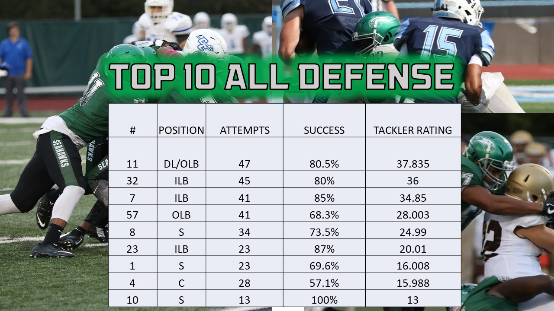
Developing A YEAR ROUND TACKLING PROGRAM
Creating measurables
Attempts
X
% Success=
tackler rating
Success is measured by your distance away from the ball at the end of the play!

