Slide 1
Rob Hinson, HFC Timber Creek HS Erial, NJ (856) 232-9703, Ext.7651 Rhinson@BHPRSD.org

Slide 2
Coverages
We are a team that run multiple coverages depending on our front called. This past season, we ran Tite (4-4), Under (5-2), and situationally some Raven (3-4).

Slide 3
Identifying Receivers
#3 #3
O O
#2 #2
#1 O Q O #1
O X O

Slide 4
Tite
Primary coverages run:
Cover 0
Cover 1
Cover 3
Cover 4

Slide 5
Formation Adjustments (Tite)

Slide 6
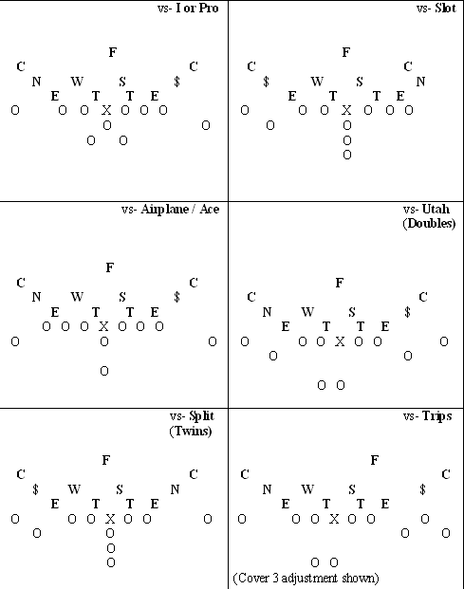

Slide 7
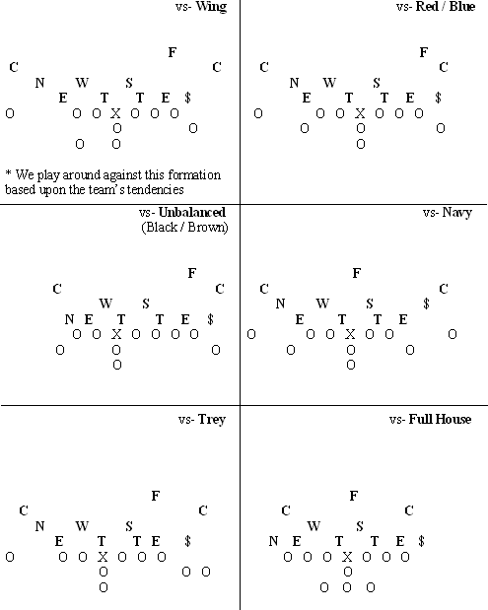

Slide 8
Tite coverages

Slide 9
Coverage Rules & Concepts
Cover 1:
CB- #1 Receiver
$/N- #2 Receiver
S/W- #3 Receiver if a RB
F- Deep Middle

Slide 10
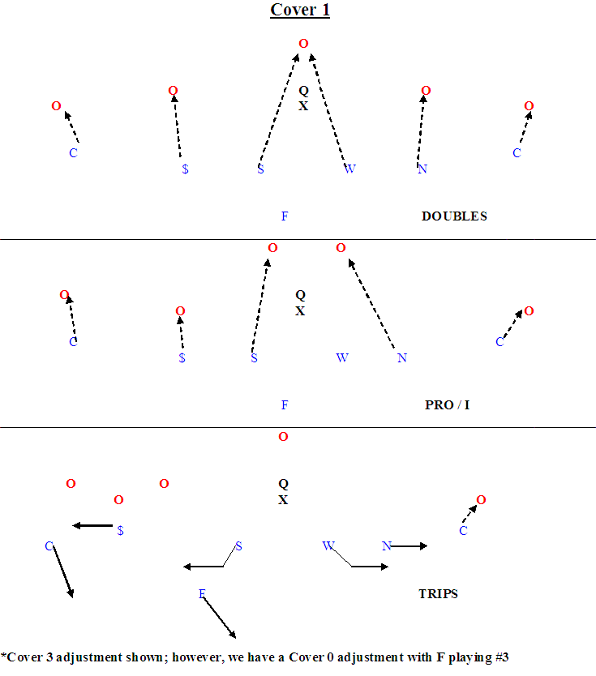

Slide 11
Cover 1 (Cut-ups)
http://www.hudl.com/library/12937

Slide 12
Coverage Rules & Concepts
Cover 0
The responsibilities are the same as Cover 1 with the exception of the “tagged” or blitzing defender.
Example- If the $/N is blitzing, F would assume his man responsibility

Slide 13
Cover 0 (Cut-ups)
http://www.hudl.com/library/12937

Slide 14
Coverage Rules & Concepts
Cover 3
CBs- Deep outside 1/3
$/N- Flats
S/W- Hook/Curl
F-Deep middle 1/3

Slide 15
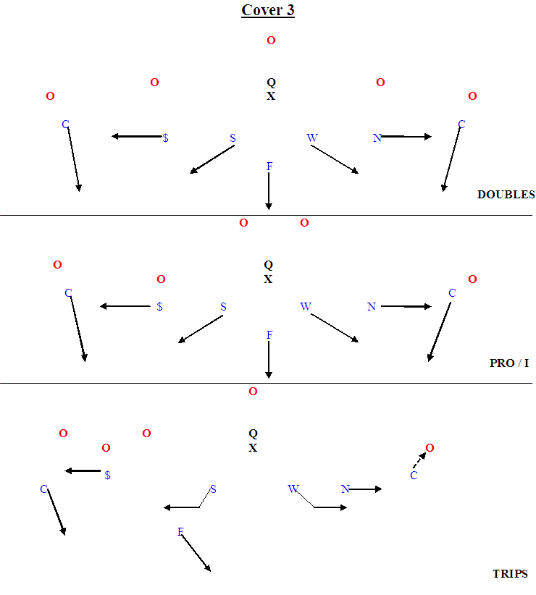

Slide 16
Cover 3 (Cut-ups)
http://www.hudl.com/library/12937

Slide 17
Coverage Rules & Concepts
Cover 4
CBs- Outside 1/4s
N- Split difference between #2 & #3
S- Drop underneath #3 strong
W- Drop underneath #2
$- Middle 1/4 strong
F- Middle 1/4 weak
Keep everything in front of us

Slide 18
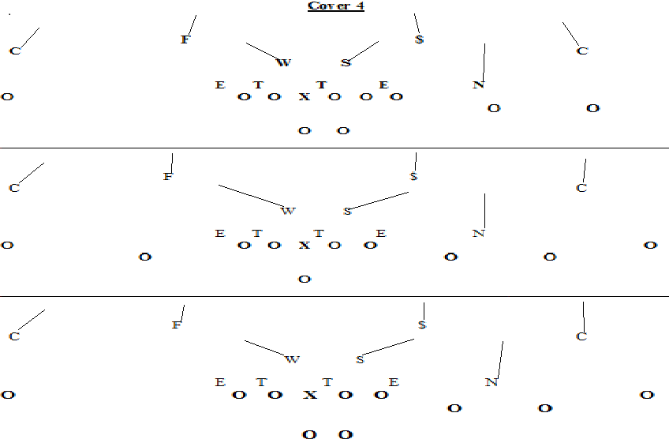

Slide 19
Cover 4 (Cut-ups)

Slide 20
Under
Primary coverages run:
Quarters (we call it READ)
Cover 0 (essentially our Quarters, but we “lock” it
Cover 4 (true 4 deep)

Slide 21
Formation Adjustments (Under)
Notes:
Insert WORD Drawings

Slide 22
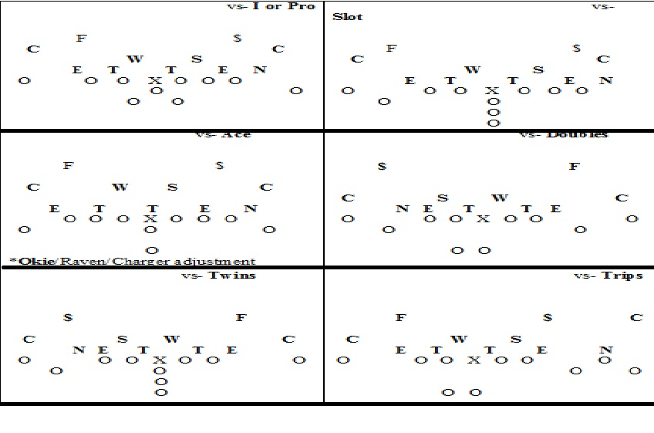

Slide 23
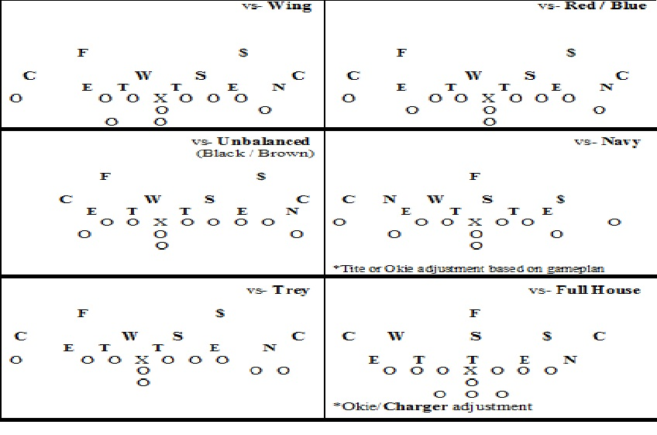

Slide 24
Under coverages

Slide 25
Coverage Rules & Concepts
Cover 0
CBs-#1
F/$- #2
We will “lock” it, meaning we won’t read the route of #2 receiver

Slide 26
Coverage Rules & Concepts
Read (Quarters)
CBs-#1
F/$- #2
If #2 runs an arrow or bubble, the CB will now have #2 and the F/$ will now have #1

Slide 27
Raven
Primary coverages run:
Situational (long yardage, end of half, end of game)
Cover 4
Cover 5 (2-Man)

Slide 28
Formation Adjustments (Raven)
Notes:
Insert WORD Drawings

Slide 29
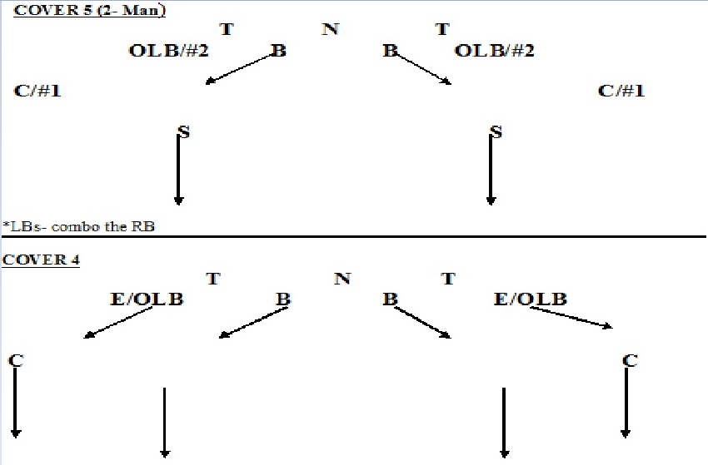

Slide 30
Raven coverages

Slide 31
Coverage Rules & Concepts
Cover 4
CB/FS/$- Deep 1/4
OLB- Flats
ILB- Hook/Curl
No big plays, everything kept in front

Slide 32
Coverage Rules & Concepts
Cover 5 (2-Man):
CB- #1 Receiver
OLB- #2 Receiver
ILB- #3 Receiver if a RB
FS/$- Deep 1/2

Slide 33
Motion adjustments (Tite)
We have the capability of a two number system.
The first number is the pre-motion call, and the second number would be the “motion” call.
From Cover 1, we’ll run:
“10”
“13”
“14”
“41”

Slide 34
“10”
Pre-Snap- Cover 1
Will become “10” when we rotate FS into man coverage
The FS’s responsibility will be determined by game plan or type of motion.

Slide 35
“10” cut-ups
http://www.hudl.com/library/12937

Slide 36
“13”
Pre-Snap- Cover 1
Will become “13” with motion beyond the OC
$/N will become Flat/Wheel player
Jet or teams that attack the flats with motion
Run situations

Slide 37
“13” cut-ups
http://www.hudl.com/library/12937

Slide 38
“14”
Pre-Snap- Cover 1
Will become “14” with motion beyond the OC
$/N will become Hook/Curl player
PSLB will drop under #3
Passing situations; keeping everything in front of us

Slide 39
“14” cut-ups
http://www.hudl.com/library/12937

Slide 40
“41”
Pre-Snap- Cover 4
Will become “41” with motion from 3x1 to 2x2
$ will roll down; $ & CB will banjo the 2 receivers to motion side
CB& N will banjo the 2 remaining receivers

Slide 41
“41” cut-ups

