Slide 1
1 Scheme…Multiple Plays
Let the OLine play with confidence and the ball handlers have fun
Rich Alercio
Assistant AD/Head Coach
St Johnsbury Academy (VT)
e: ralercio@stjacademy.org
o: 802-751-2421
: @olineskills
w: www.olineskills.com
www.olineskills.com

Slide 2
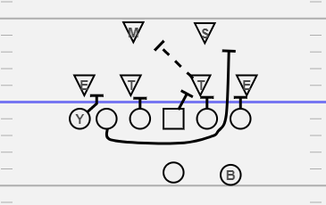
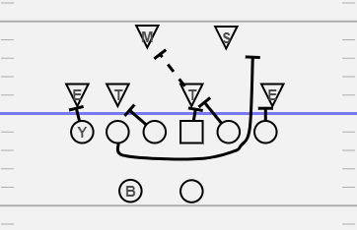
Counter / Dart
Counter (To side or Back)
Dart (Away from Back)
PST – Block #2 on LOS (DE)
Jump Set C, Drive B
PSG – Block #1 on LOS (DT)
Jump Set B, Combo A
C – Block Middle/Backside LB (Mike)
Combo with A Gap DT Guard
BSG – Block #1 on LOS (DT)
Jump Set B, Combo A
BST – Lead Pull to block 1st LB playside (Sam)
TE – Block #2 on LOS (DE)
Jump Set D, Cut off C

Slide 3
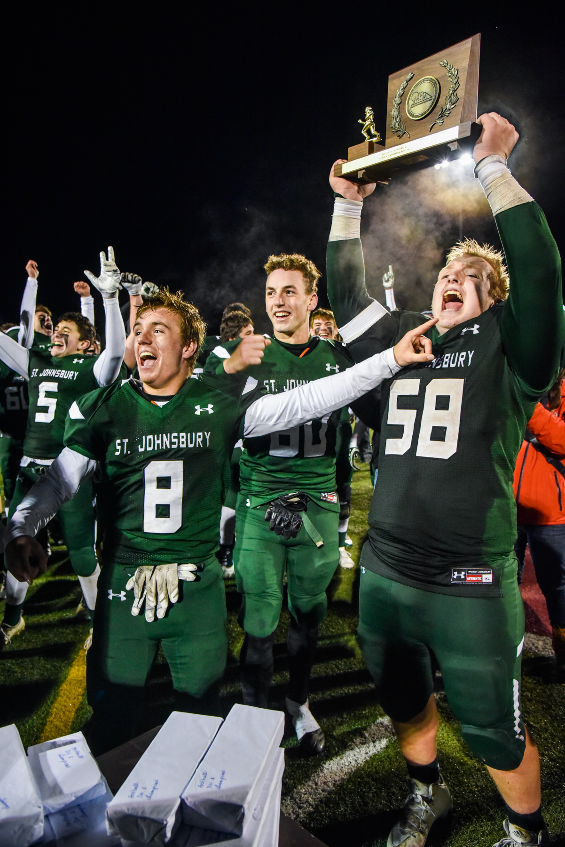
Counter / dart scheme average
98 Runs* for 763 Yards = 7.8 yds/run
*Does not include Bubbles, Smokes,
Isolations, Penalties
Starting QB Avg = 9.3 yards
Starting RB Avg = 8.2 yards

Slide 4
counter

Slide 6
Draw Counter

Slide 8
q counter (Orbit)

Slide 10
Jet q counter

Slide 12
Empty q counter

Slide 14
dart

Slide 16
Sprint dart

Slide 18
Q dart

Slide 20
No Attached Tight end needed
Versus 3-4
Q Counter
Reads
Dart Read (Orbit)
Swing Q Dart

Slide 21
1 Scheme…Multiple Plays
Let the OLine play with confidence and the ball handlers have fun
Rich Alercio
Assistant AD/Head Coach
St Johnsbury Academy (VT)
e: ralercio@stjacademy.org
o: 802-751-2421
: @olineskills
w: www.olineskills.com
www.olineskills.com

