Slide 1
The Value of Football
David Walker
Head Football Coach
Martinsburg High School
Martinsburg WV

Slide 2
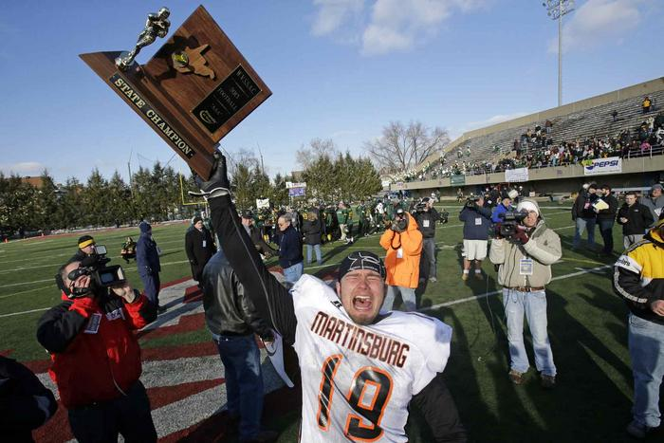
MARTINSBURG FOOTBALL
AAA State Championships – 2010, 2011, 2012, 2013, 2016, 2017

Slide 3
SCHOOL
Martinsburg High School
1,325 students 9-12
Most Diverse school in West Virginia
23 different nationalities
60 percent of students receive free and reduced lunch

Slide 4
COMMUNITY value
Transient community
Drug issues
Economic issues
Importance of football

Slide 5
HOME value
Broken homes
Broken values
Molding men
Character

Slide 6
LEADERSHIP value
Natural leaders
Born leaders
Taught leaders
Shared leadership

Slide 7
Social Value
Game is under scrutiny; we need football now more than ever!
Social media
Changing priorities within America
Instant gratification
Life is difficult, and football is about overcoming challenges
Springboard for life
Have fun

Slide 8
TEAMWORK value
Higher standards
Discipline
Diversity
Adversity
Developing strong relationships, respecting others, show care to everyone around you.

Slide 9
COACHES VALUE
Father figures
Mentors
Teaching life lessons
Call to serve – help others
Get better every day

Slide 12
Thank you
Contact information
dmwalker@k12.wv.us
304-676-6462

