Slide 1
EVERYONE SWEATS
Practical and applied Hydration
Adam Korzun, MS, RD, CSSD
Green Bay Packers

Slide 2
What is real?
…and why should I care about this

Slide 3
Why does any of this matter?
The Sales Pitch
Physical performance
Recovery
Improved on field time
Mental Focus
The Prevention
Heat stress/illness
Heat stroke
“Cramps”
Headaches

Slide 4
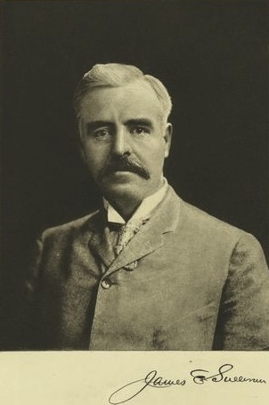
~110 years ago
1909: “Don’t get in the habit of drinking and eating in a marathon race; some prominent runners do, but it is not beneficial” – James E. Sullivan

Slide 5
~60 years ago
1960: “Four small bottles for a long stage [of the Tour], it is frowned upon to drink more…Avoid drinking when racing, especially in hot weather. Drink as little as possible, and with the liquid not too cold. It is only a question of will power. When you drink too much you will perspire, and you will lose your strength.” – Tom Simpson

Slide 6
~20 years ago
1996: “Athletes should be encouraged to replace their sweat losses or consume 150-300ml (6-10oz) every 15 minutes (600-1200ml per hour)”. – 1996 ACSM

Slide 7
~10 years ago
2007: The goal of drinking during exercise is to prevent excessive (>2% body weight loss from water deficit) dehydration and excessive changes in electrolyte balance to avert compromised performance. Because there is considerable variability in sweating rates and sweat electrolyte content between individuals, customized fluid replacement programs are recommended. Individual sweat rates can be estimated by measuring body weight before and after exercise. During exercise, consuming beverages containing electrolytes and carbohydrates can provide benefits over water alone under certain circumstances. After exercise, the goal is to replace any fluid electrolyte deficit. The speed with which rehydration is needed and the magnitude of fluid electrolyte deficits will determine if an aggressive replacement program is merited.

Slide 8
“SPORTS DRINK”
To be consumed during sport…not just because you play one
fluid
“electrolytes”
carbohydrates

Slide 9
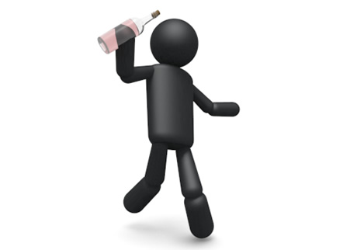
Most basic Physiology
During exercise, metabolic heat production increases in active muscles…
Up to 1 C every 5-8 minutes…
Must dissipate this excess heat to continue
We have an amazing mechanism for that…called sweat!
Thus sweating is essential BUT sweating requires fluid!
And thus…our discussion continues!

Slide 10
Applied Hydration
Simplify it to 3 questions:
Are you hydrated to start?
How much do you lose?
What do you lose?

Slide 11
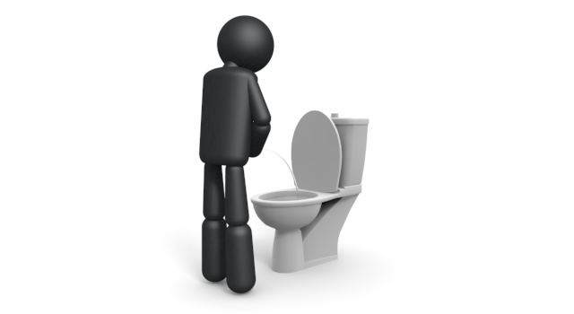
Are you Hydrated to Start?

Slide 12
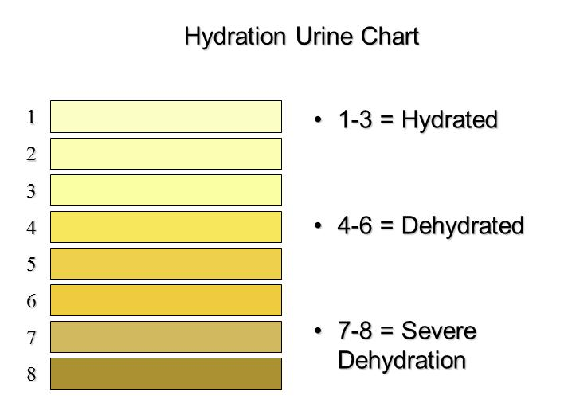
Anyone up for a little experiment?

Slide 13
Urine Specific Gravity

Slide 14
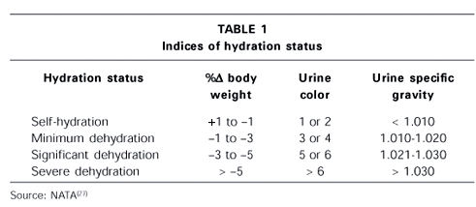
RESULTS

Slide 15
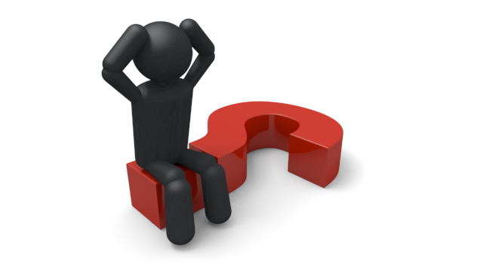
How Much Do you Lose?
Greatest Variation
Amounts change based on variables
Physical Factors
Environmental Factors
Genetic Factors

Slide 16
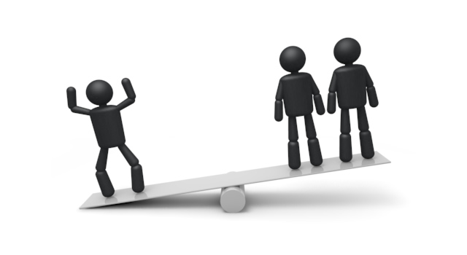
Simple Strategy
For every pound lost
=
16-20 oz water lost

Slide 17
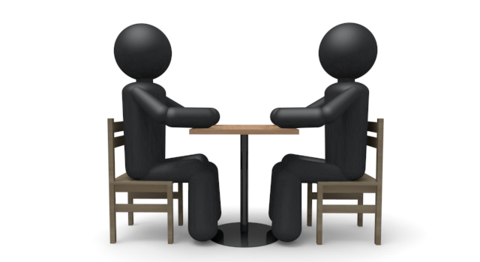
Which means
Build a strategy
Identify your high risk athletes

Slide 18
What Do you Lose?
Understanding the loss can help manage the replacement
Sweat test
Visual Cues
Taste

Slide 19
Human sweat
Electrolyte | Typical daily intake (mg) | Typical absorption efficiency | Typical sweat losses per litre | Loss in litres of sweat to be deficient | Deficiency possible by sweating?
Sodium | 4000 | >90% | 230-1700 | 4 | Yes
Potassium | 2700 | >90% | 150 | 16 | No
Calcium | 500 | 30% | 28 | 5 | Possible
Magnesium | 300 | 10-70% | 8.3-14.2 | 15 | No
Table shows typical human sweat composition

Slide 20
A little more on “cramps”
What exactly is a cramp?
How do I “fix” it
How not to overreact.
What causes a cramp?
Control the variables

Slide 21
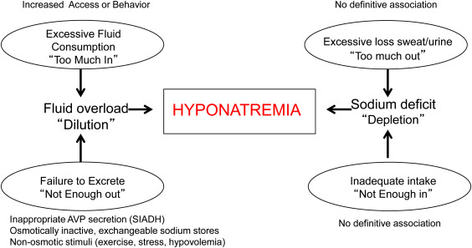
Exercise associated Hyponatremia
Inappropriate Overconsumption of Water
Excessive sodium losses
Excessive intake
“over-reaction to cramping”

Slide 22
what are my options to drink?
Commercially available options
Gatorade
Higher sodium; lower sugar
Electrolytes; no sugar
Custom and Individualized

Slide 23
Homebrew hydration options
1 packet KoolAid
1 cup sugar
1teaspoon Salt
4 qt Water
(double the packet)
Per 8oz serving (Gatorade)
12g sugar (16g)
143mg sodium (104mg)

Slide 24
As Hydration Evolves
What do you sweat?
How much do you sweat?
With what/how do you need to hydrate?

Slide 25
In case you missed it – Q & A
Are you hydrated?
How much do you lose?
What do you lose?
Make sure you are hydrated.
How much should you drink.
What should you drink.

Slide 26
Questions?

Slide 27
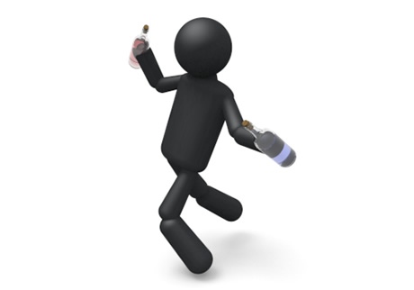
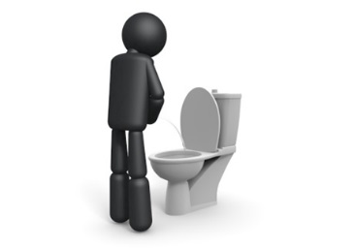
Hydration

